Slide 1
Political and constitutional development 1935-1947
Government of India Act 1935
1937 elections and formation of congress ministries
1940 Pakistan Resolution
Cripps Mission 1942
Cabinet Mission 1946
3rd June Plan and transfer of Power

Slide 2
Government of India Act 1935
Three lists of subjects were drawn up
Federal list
Federal government could make laws in the subjects given
Provincial list
Provincial government could make laws in the subjects given in the list
Concurrent List
Both Federal and provincial government could make laws
System of dyarchy was transferred from provinces to center.
Sindh was separated from Bombay, and Orissa Separated from Bihar.

Slide 3
NWFP was made province and Burma was separated from British India.
Special powers given to the governors of the provinces to protect the rights of the minorities.
India was divided into 11 provinces; Bihar, Orissa, Bengal, Punjab, Bombay, Madras, Sindh, NWFP, Central Provinces and Berar, United Province, assam.
1937 elections and formation of Congress ministries
The provincial elections were announced soon after the passage of the Government of India Act 1935 in 1936-37
Results of elections
The results of the elections were disappointing for the Muslim League, as the Congress won majority seats and formed ministries in eight provinces. Bihar, Orissa, Berar and Central Provinces, NWFP, Assam, Madras and Bombay. In Punjab, Unionist party formed ministry. In Bengal, a coalition government was formed of Congress. In Sindh, Sindh united party won major seats.

Slide 4
Muslim league failed to win seats in the Muslim majority provinces but managed to get seats in Muslim minority province like UP.
Pakistan Resolution 1940
British declared war against Germany and made India part of War without taking opinions of the Indian Legislators, due to which Congress ministries resigned.
After two years of Congress rule the Muslims have realized that if the British left India then the Congress will dominate in the central legislature. Due to which Muslim league changed its politics from united India to partition of India.
Muslim League presented the Pakistan Resolution in Lahore. A.K Fazl ul Haq presented the resolution and Jinnah presided the session.

Slide 5
Text of the Lahore Resolution 1940
“No constitutional plan would be workable in this country or acceptable to the Muslims unless it is designed on the following basic principles, namely, that the geographically contagious units are demarcated into regions which should be so constituted, with such territorial readjustments as may be necessary, that the areas in which the Muslims are in a majority as in the north-western and eastern zones of India should be grouped to constitute independent states in which the constituent units shall be autonomous and sovereign. Adequate, effective and mandatory safeguards should be specifically provided in the constitution for minorities for the protection of their religious, cultural, economic, political, administrative and other rights”

Slide 6
Elections 1945-46.
The AIML won all the seats reserved for Muslims at the central legislature, and won 446 out of 496 seats reserved for the Muslims in the provinces
Cabinet Mission plan 1946
Socio-economic conditions of India
India was passing through an economic crisis after the WW-II.
The inflation and the unemployment
Announcement of Cabinet Mission
The new British government headed by Lord Attlee, announced a mission for India consisting of three cabinet ministers on February 19, 1946.

Slide 7
The ministers which were included in the mission were; Petherick Lawrence, A.V Alexander, and Stafford Cripps.
The mission was given the task to resolve the constitutional issues with the Viceroy and the Indian political leaders.
Major points
Indian Union would be established comprising of British India and the states. The Union would deal with the defense, foreign affairs, and communication.
Three groups of provinces would be established
Group A: Punjab, Sind, Bengal, NWFP
Group B: Madras, Bihar, Orissa, UP, CP, Bombay
Group C:Aasam, Bengal

Slide 8
All residuary powers would be vested in the provinces
Each province have seats in proportion to its population
Each province have the option of opting out of the provincial groups after 10 years.
An interim government would be established with all portfolios held by the Indians.
Failure of interim government formation.
The Viceroy declared that whichever party was willing to join the interim government would be invited to form the interim government.
INC refused to join the interim government, on the other hand the AIML decided to join the government. but Viceory did not ask Jinnah to form government.
Jinnah decided to take direct action along with withdrawing their acceptance of the Cabinet Mission plan.

Slide 9
Transfer of power to India and Pakistan from British government
The British Prime minister Lord Attlee declared in British parliament that India would be granted independence by February 1948.
Lord Mountbatten was sent to India with the orders by the British government to transfer the power up to the June 1947.
3rd June Plan
After having discussion with political leaders of India, Lord Mountbatten decided to partition India.
Both AIML and INC gave their acceptance to the draft partition plan. Mountbatten went to England to take approval of the British government.
The British government approved the partition plan, which was known as the 3rd June plan

Slide 10
Major points
The Punjab and the Bengal legislature would decide to partition the province or not
Referendum in NWFP and Sylhet.
Sindh Assembly was asked to decided which country they wanted to join
In Baluchistan Shahi Jirga was to decide would be asked to decide their future
A boundary commission was formed to demarcate the borders.
Both countries shall have their own Governor-General
Military assets shall be divided among the two countries
States shall be free to join one country or another
Radcliff award
A Boundary commission was setup under the chairmanship of Sir Cyril Radcliff to demarcate the borders of Punjab and Bengal.

Slide 11
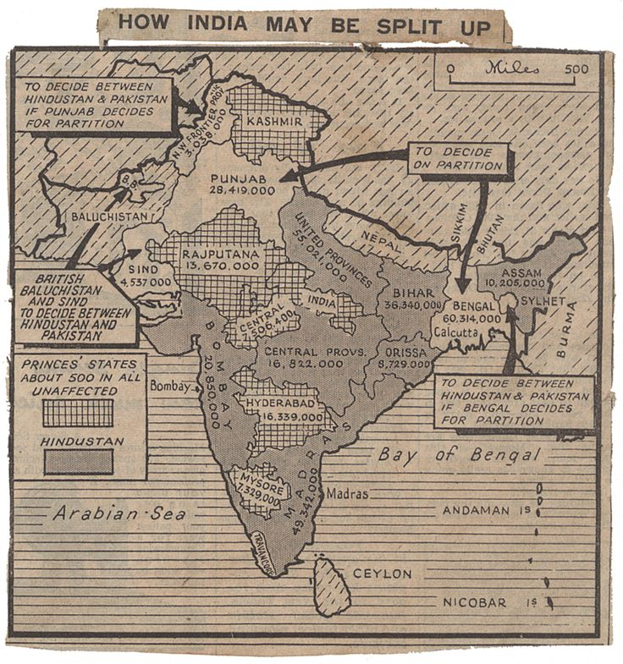

Slide 12
Both Punjab and Bengal decided to partition.
Sindh Assembly and Shahi Jirga of Baluchistan decided to join Pakistan.
The Referendum in NWFP and Sylhet also turned in favor of Pakistan.
In Bengal the Muslims were 55% and in Punjab the Muslims were 57%. But still the province was partitioned.
When Muslim League leaders argued with Mountbatten he argued that Lahore Resolution has not made it clear that that the Muslim state should be composed of whole Provinces of Punjab, Bengal and Assam.
The Lahore Resolution used the phrase “areas in which the Muslims are numerically in a majority as in the North-Western and Eastern zones of India.

Slide 13
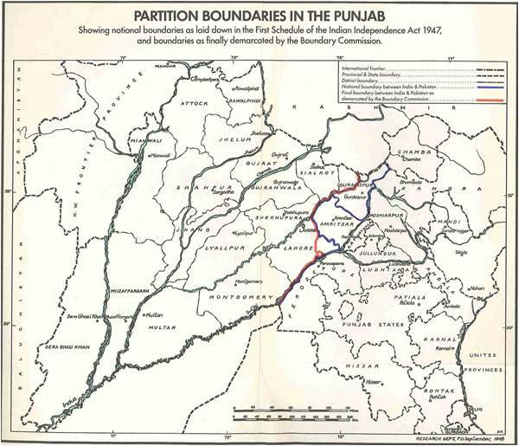

Slide 14
